Slide 1
Bike Store Sales Data Analysis

Slide 2
This data provides a detailed overview of bike product sales in the USA over a three-year period(2021 to 2023). It covers sales across different brands, states, cities, and stores. Additionally, it includes information about individual sales representatives, including the commissions they earned.

Slide 3
SALES STATISTICS
$58.69M
$21.35M
Actual Revenue
Total Profit
$55.99M
$17.21M
Net Revenue
Net Profit
$2.70 M
$4.14M
Discount Paid
Commissions Paid

Slide 4
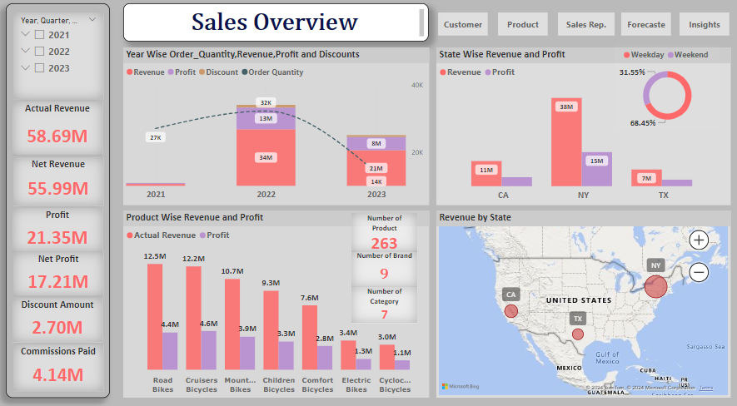

Slide 5
SALES STATISTICS
Profit
01
Between 2021 and 2023, New York generated $15 million in profit, Texas generated $3 million, and California generated $4 million.
Revenue
02
Between 2021 and 2023, New York generated $15 million, Texas generated $7 million, and California generated $11 million in revenue.
Weekday vs Weekend
03
Out of the $55.99 million in net revenue, 68.45% is generated on weekdays, and 31.55% is generated on weekends.
Product
04
There are a total of 263 products across 9 brands and 7 categories.

Slide 6
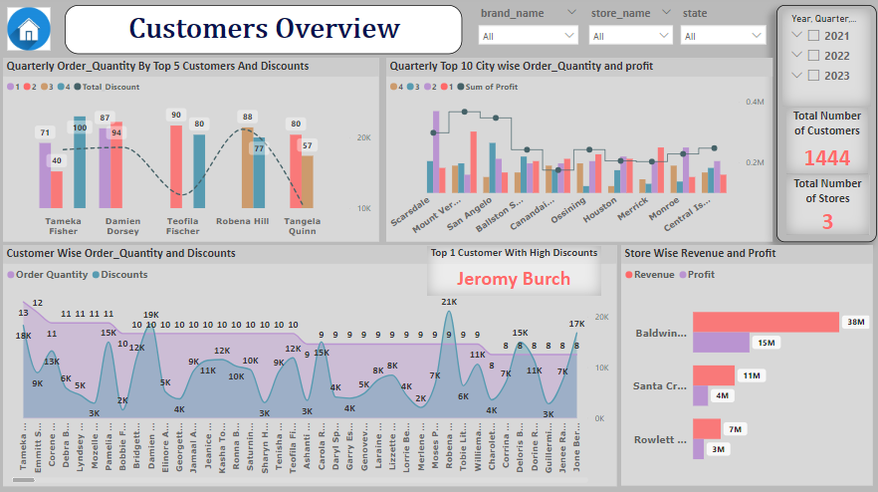

Slide 7
SALES KPI
1444
Total number of Customers
TAMEKA FISHER
TOP 1 customer who ordered highest Order_quantity of 211
3
Total Number of Stores
JEROMY BRUCH
Top 1 Customer Got Highest amount of Discount of 22788
STORE : BALDWIN BIKES
Revenue: 38m Profit: 15M

Slide 8
SALES KPI
Product Categories
Product Brand
APRIL
The highest number of order quantities, 699, was observed in the month of April within the years 2021 to 2023.
Out of 7 Product Categories Road Bikes generates more revenue of 21.31%
Out of 9 Brands Trek Brand Generates Highest revenue of 1477k
ELECTRA TOWNIE ORIGINAL 21D
ELECTRA
Top 1 Product Brand Name with Order_Quantity
Top 1 Products Name with Highest order_Quantity

Slide 9
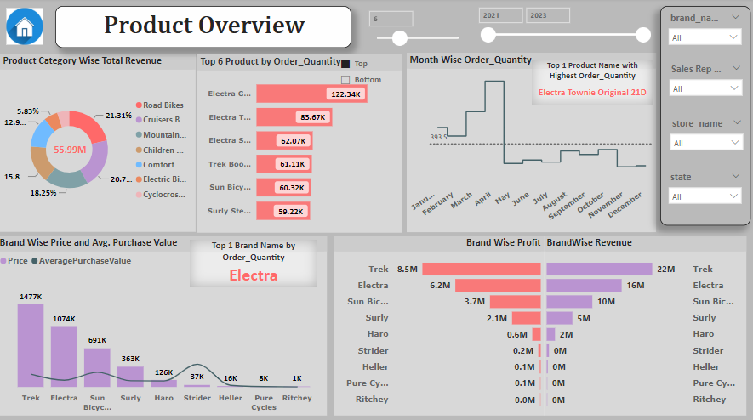

Slide 10
SALES STRATEGY INFOGRAPHICS
MERCURY
Mount Vernon secures the second position with 60 orders and the highest profit amount of $3,67,821.16 among these top 10 cities.
Scarsdale holds the first position, ordering 61 products with a profit of $2,98,392.15.
There are a total of 3 stores with branches spanning across 3 states and 195 cities in the USA. Among these stores, Baldwin Bikes leads with the highest revenue and profit generation, amounting to $3,79,83,162.09 in revenue and a profit of $1,46,57,990.09.
Venus has a beautiful name and is the second planet

Slide 11
SALES REP. DETAILS
MARCELENE BOYER
195
Top 1 Sales Rep. With the Highest Commissions.
Total Number of Cities
73.25K
6
Total Order_Quantity
Total Number of Sales Rep.

Slide 12
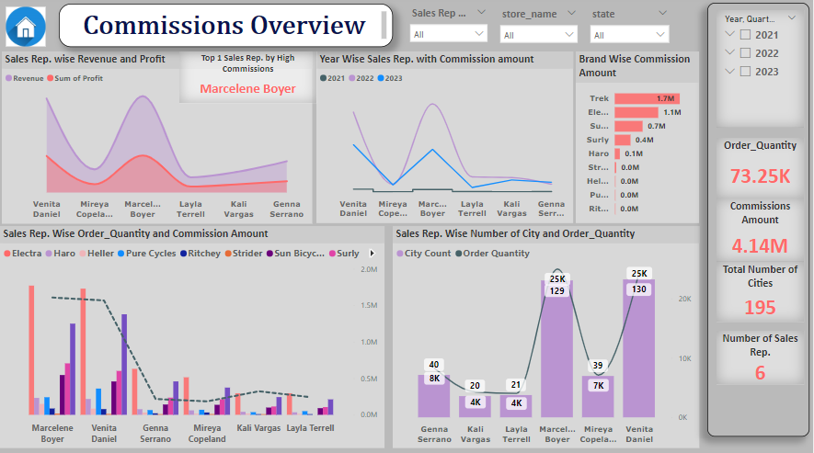

Slide 13
SALES REP. DETAILS
MERCURY
Among all 6 sales representatives, Marcelene Boyer is the top performer, generating the highest revenue and profit of $192,290,082.38 and $73,857,769.38, respectively. Kali Vargas also performs well, contributing $41,667,78.54 in revenue and $16,357,95.54 in profit. Venita Daniel secures the second-highest revenue with $187,540,79.71 and a profit of $72,722,20.71. Genna Serrano generates revenue of $62,149,50.16 and profit of $22,426,82.16. Mireya Copeland achieves revenue of $46,043,59.73 and profit of $16,412,27.73. Layla Terrell is the lowest-performing sales representative, generating $30,251,88.02 in revenue and $11,725,66.02 in profit.
Venus has a beautiful name and is the second planet

Slide 14
We have generated a year-wise revenue forecasting model for the upcoming three years. During our analysis, we observed the forecasted values for different areas, including the ForecastPoint value, as well as the Upper and Lower Bound Values for each quarter over the three-year forecasting period.
In our yearly table categorized by quarters, we have observed the Return on Investment (ROI%) for each quarter. Across the 12 quarters, the highest ROI% was recorded in 2021 Quarter 2 at 87.06%. Conversely, the lowest ROI% was observed in Quarter 2 of the year 2023, amounting to 58.04%.

Slide 15
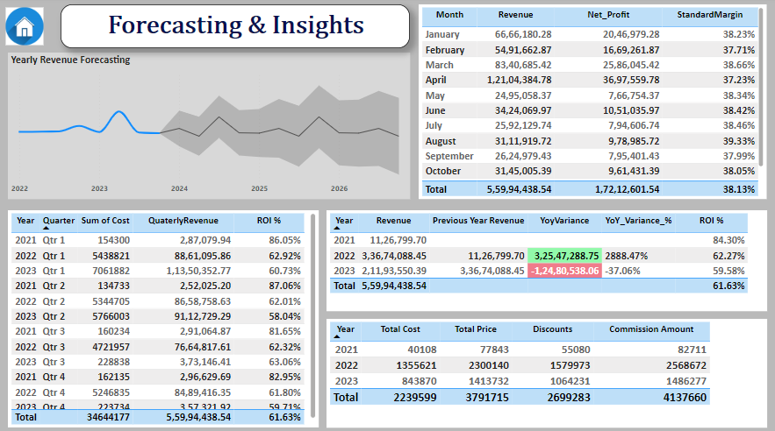

Slide 16
We have generated a yearly report focusing on the percentage change in growth over quarters and months. Through the use of the drilldown option, we can observe the variations in the data.
Specifically, we noticed that Quarter1 exhibited the highest quarter-over-quarter (QOQ) growth rate at 133.31%. In contrast, Quarter 3 displayed a negative growth rate of -53.79%.

Slide 17
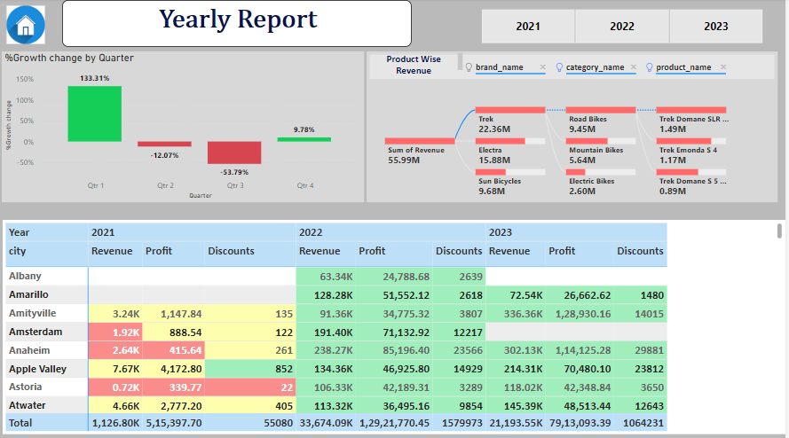

Slide 18
THANK YOU

